Slide 1
Welcome to Amate school management system
Exam Management System

Slide 2
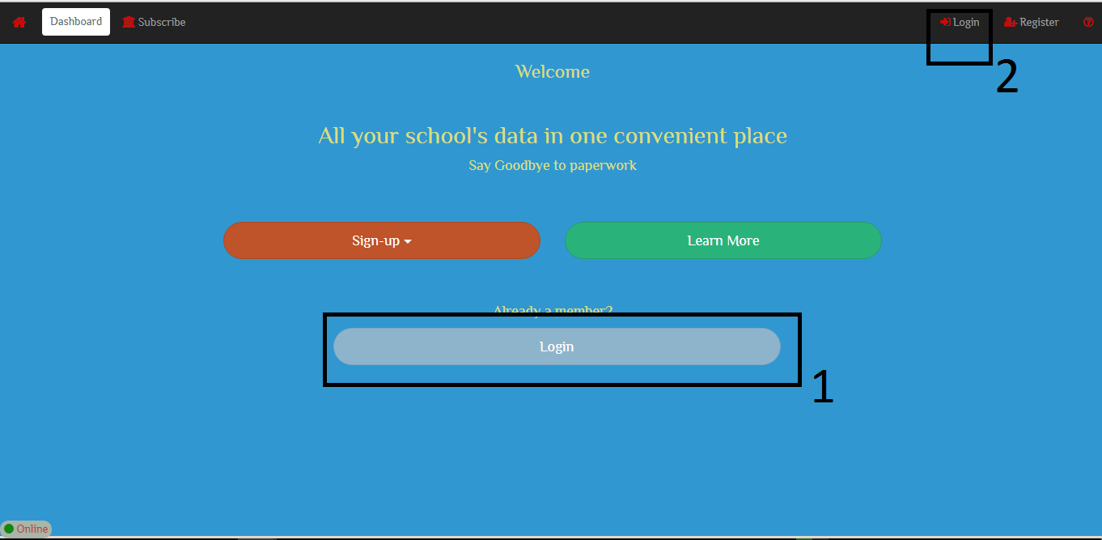
1. Click on either of the login buttons

Slide 3
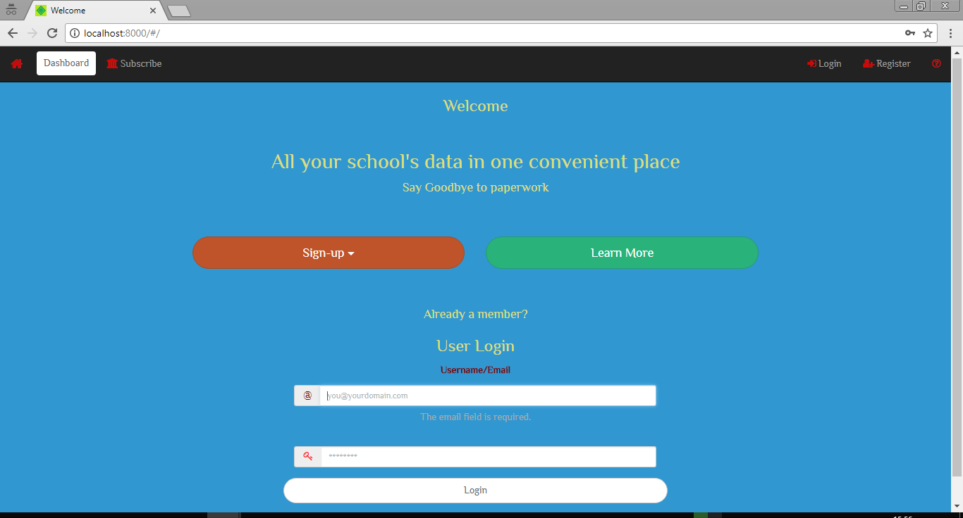
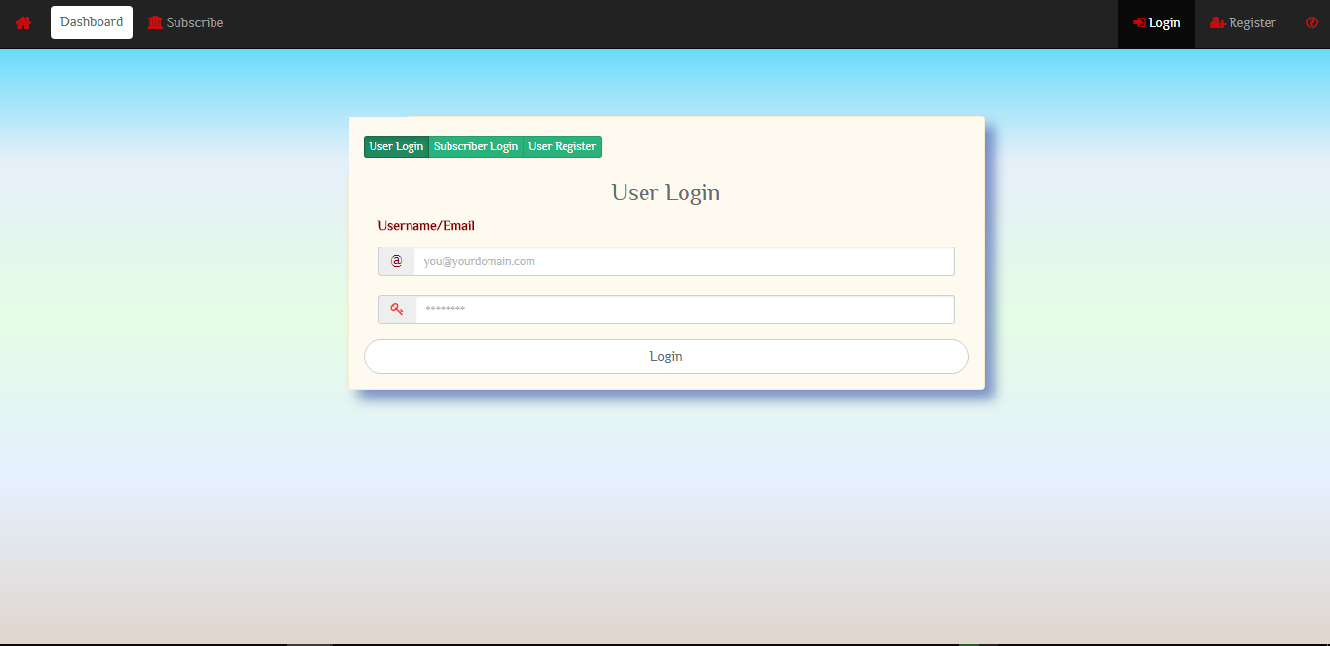
2. Login to your acount.

Slide 4
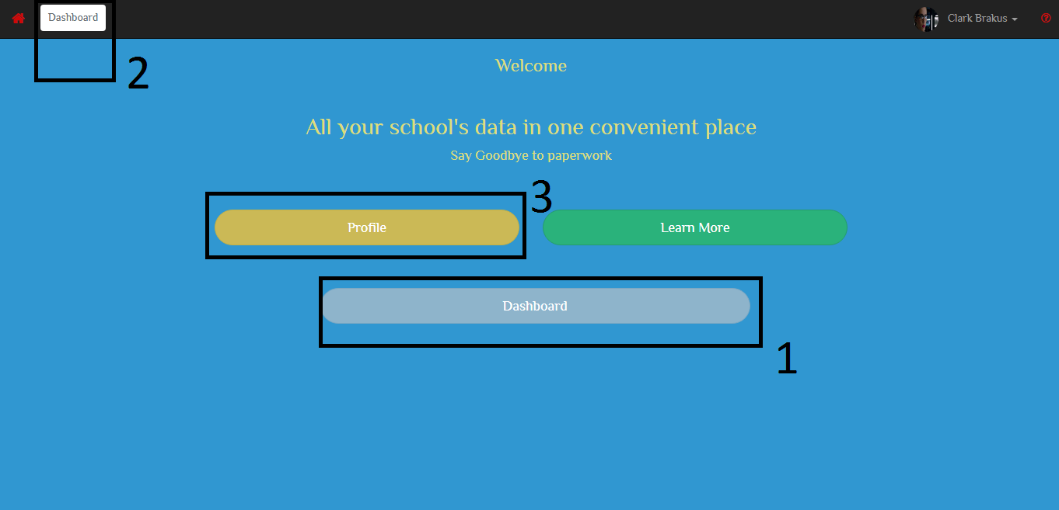
Click on either of the 3 buttons to access the dashboard or view your profile.

Slide 5
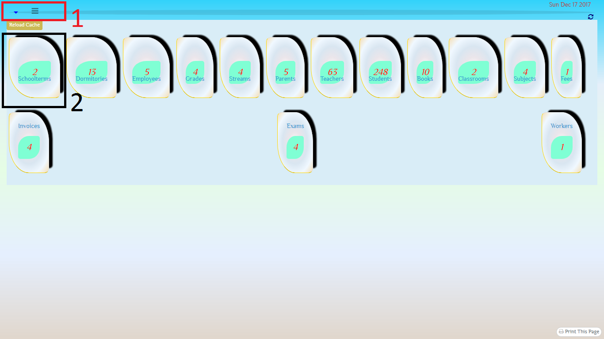
From the dashboard, use the buttons labelled 1 to access the menu. Proceed to Schoolterms by selecting panel labelled 2

Slide 6
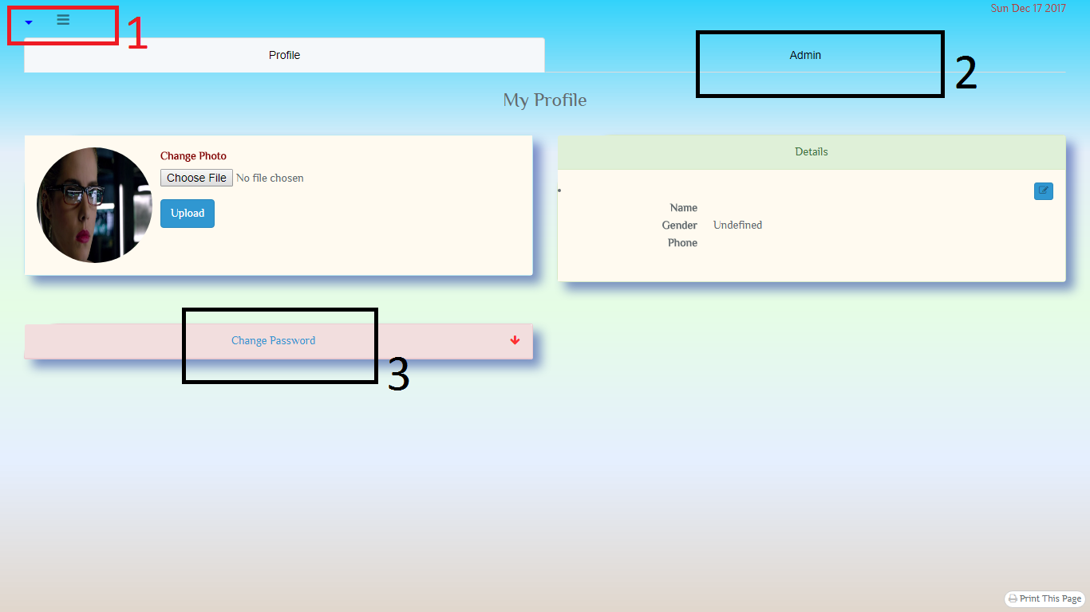
From the profile, use buttons labelled 1 to access the menu, link 2 accesses the admin panel and link 3 give you the ability to change your password.

Slide 7
5. Add Schoolterm
The first thing to do is create your schoolterms.
A good example in Kenya is ‘Term 1’, ‘Term 2’ and ‘Term 3’.
You will use these schoolterms to create your classrooms later.
The page gives you clear instrutions on how to create schoolterms.

Slide 8
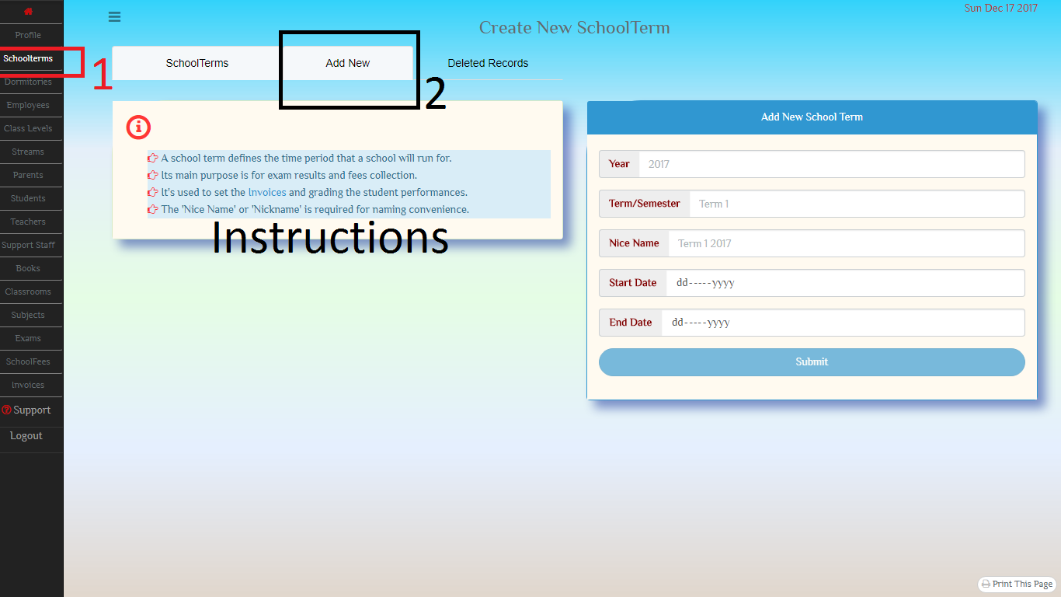
5.1 Add school term

Slide 9
6. Add Grade and Streams
You will add the grades that your institutions have.
Example, 1 – 8 for Primary schools, 1-4 for secondary schools.
Proceed and create streams. At least one stream is required. Different stream naming system exists such the points of a compass, rivers, mountains, alphabets, etc. Use whatever system you have.
You will later use a schoolterm, a grade and a stream to create a classroom.

Slide 10
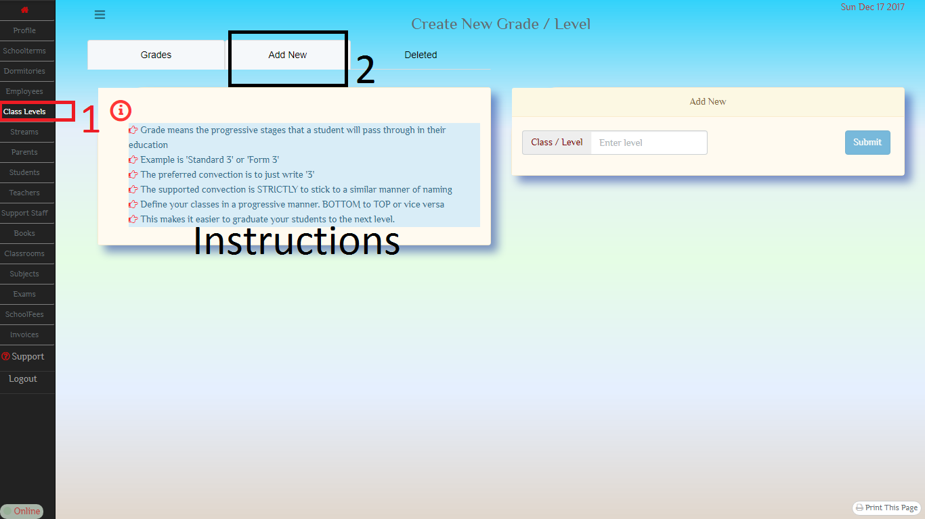
6.1 Add Grade

Slide 11
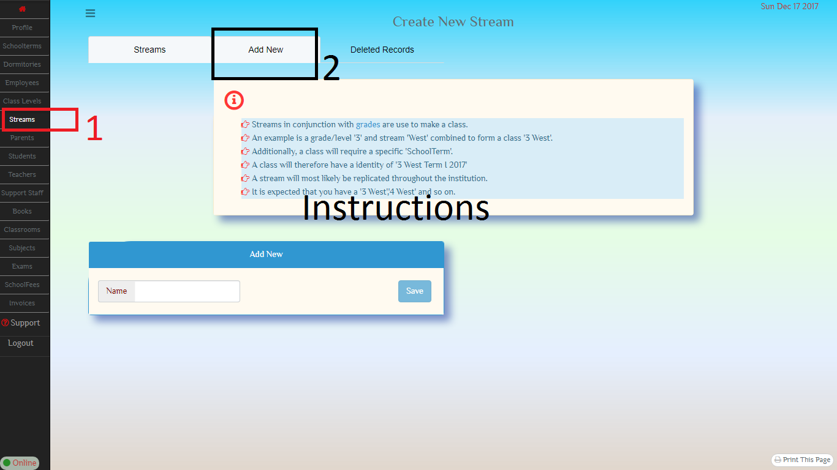
6.2 add stream

Slide 12
7. Add Parent / guardian (compulsory)
You will create a parent or a guardian to a prospective student.
Incase you do not want to store these details, create a dummy parent that will be used to add all students.

Slide 13
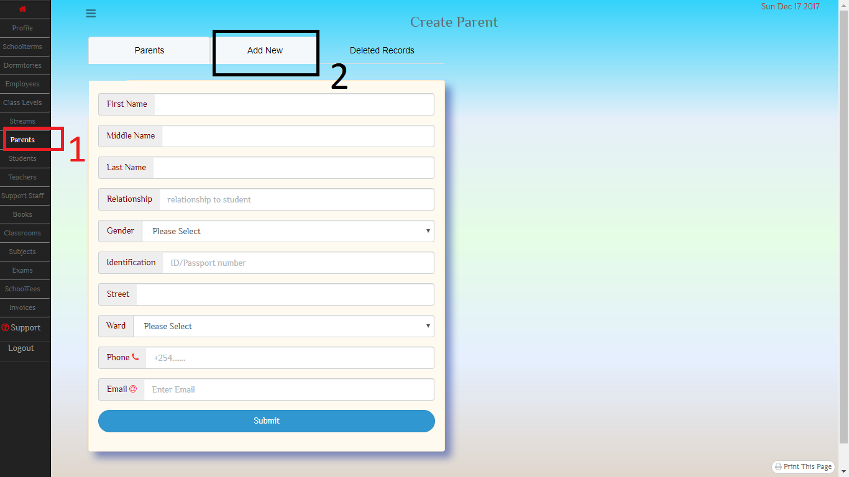
7.1 add parent/guardian

Slide 14
8. Add student
After you have created your parents, it’s time to add what really matters, the students.
Access the parents homepage
Click on a parent to add students to.
Click on ‘Add A Student to this Parent’
NOTE: When adding students, you can select the grade and stream to have the student in. This will eliminate the necessity to do it later.

Slide 15
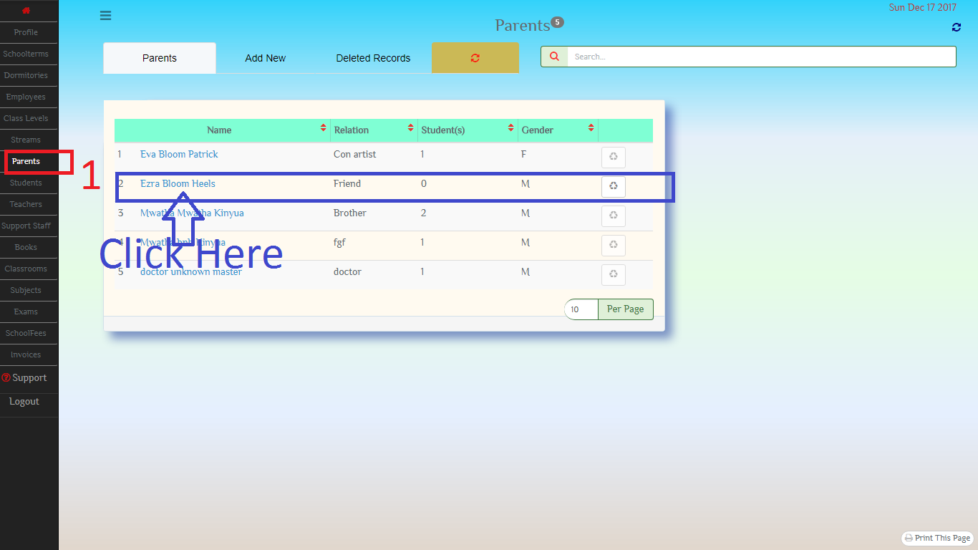
8.1 Parents’ Homepage

Slide 16
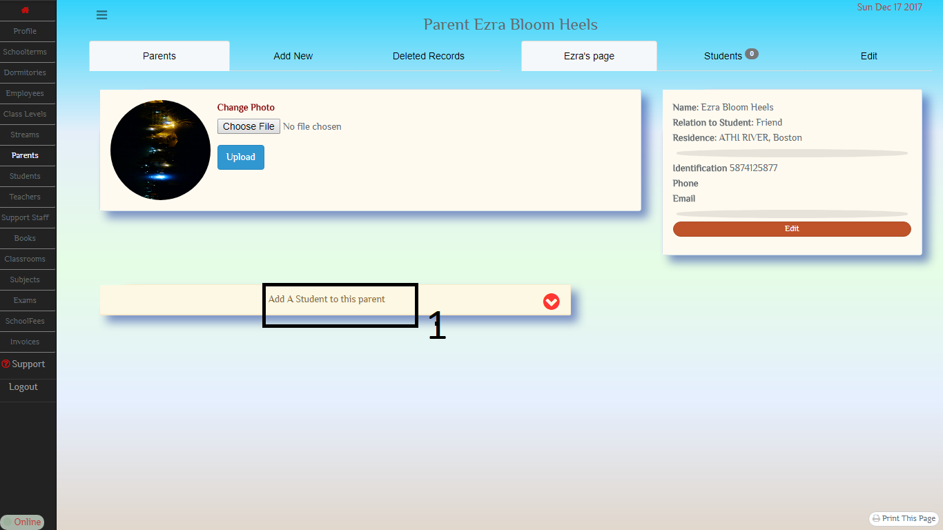
8.2 Parent’s page

Slide 17
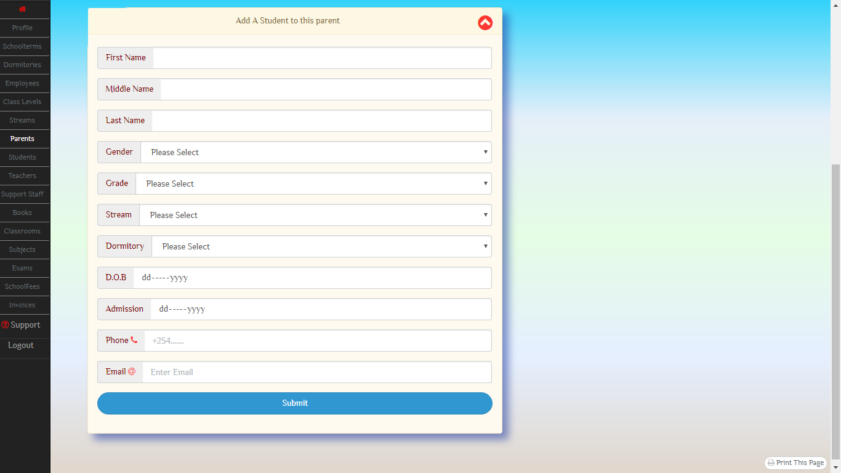
8.3 Add Student

Slide 19
9. Classrooms
Now that you have
Grades
Schoolterms
Streams
Students
You can now add classrooms.

Slide 20
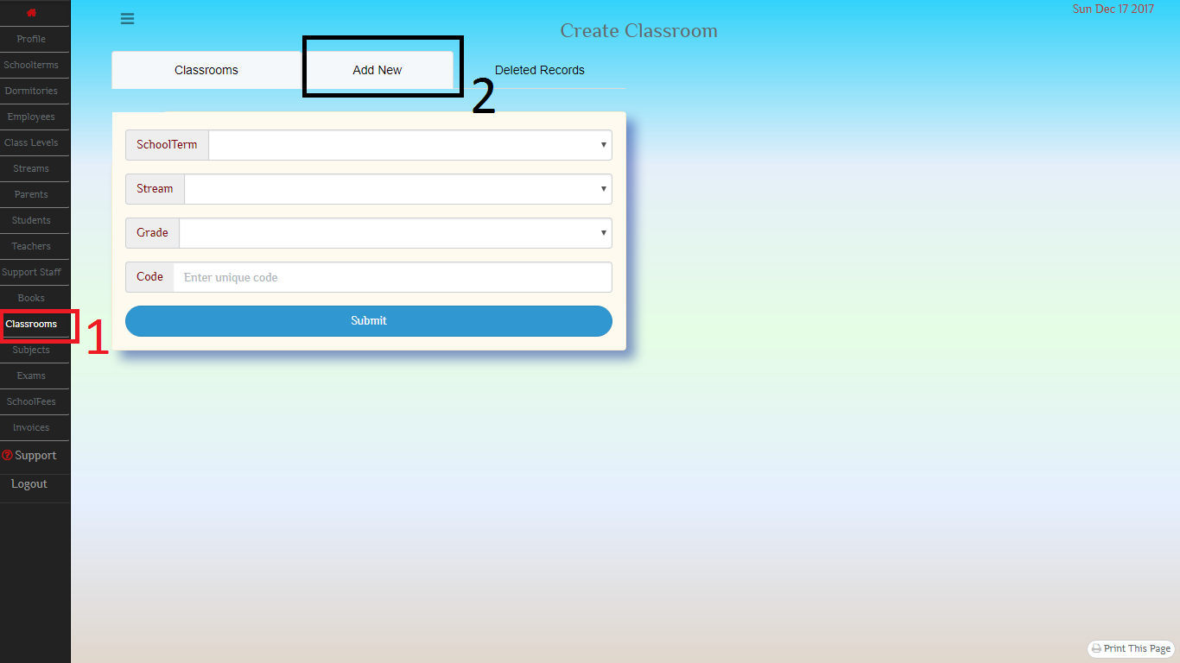
9.1 Add Classroom

Slide 21
10. it’s now time to populate your classrooms
You will now add students to your classrooms.
In order for a students to be eligible to be added to a classroom,
The student must be associated to both a stream and a grade.
The stream must be the same that the classroom is associated to,
The grade must be the same that the classroom is associated to.
You can add students to a stream by going to that stream’s homepage.
You can add students to a grade by going to that grade’s homepage.

Slide 22
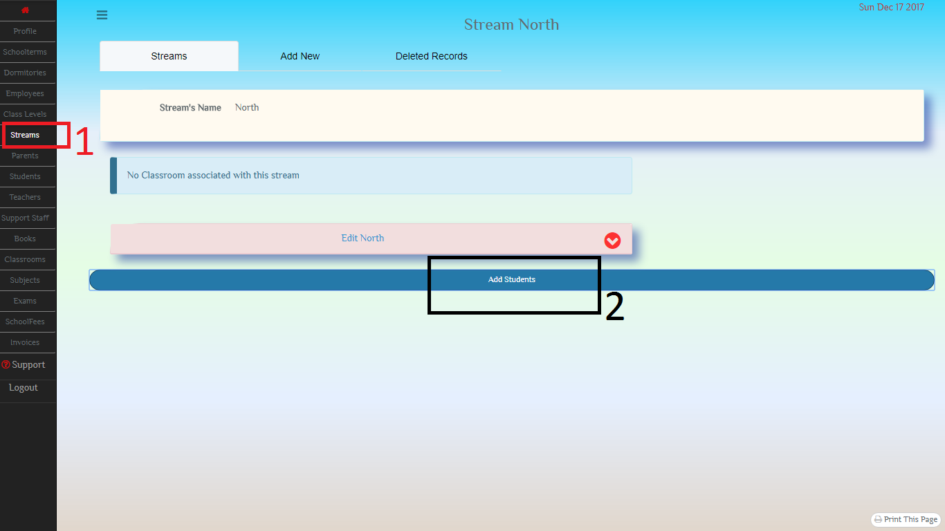
10.1.1 Add Students to stream

Slide 23
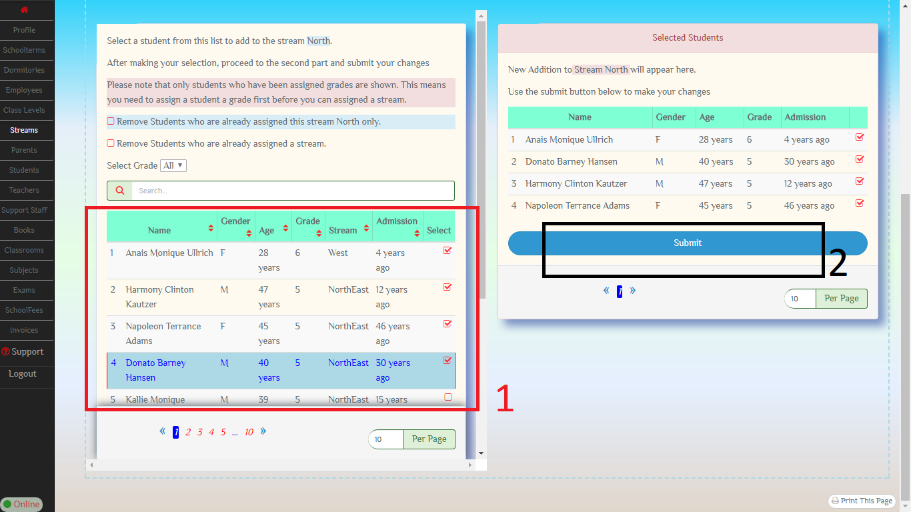
10.1.2 Choose the students from list [1] and submit [2] to save changes

Slide 24
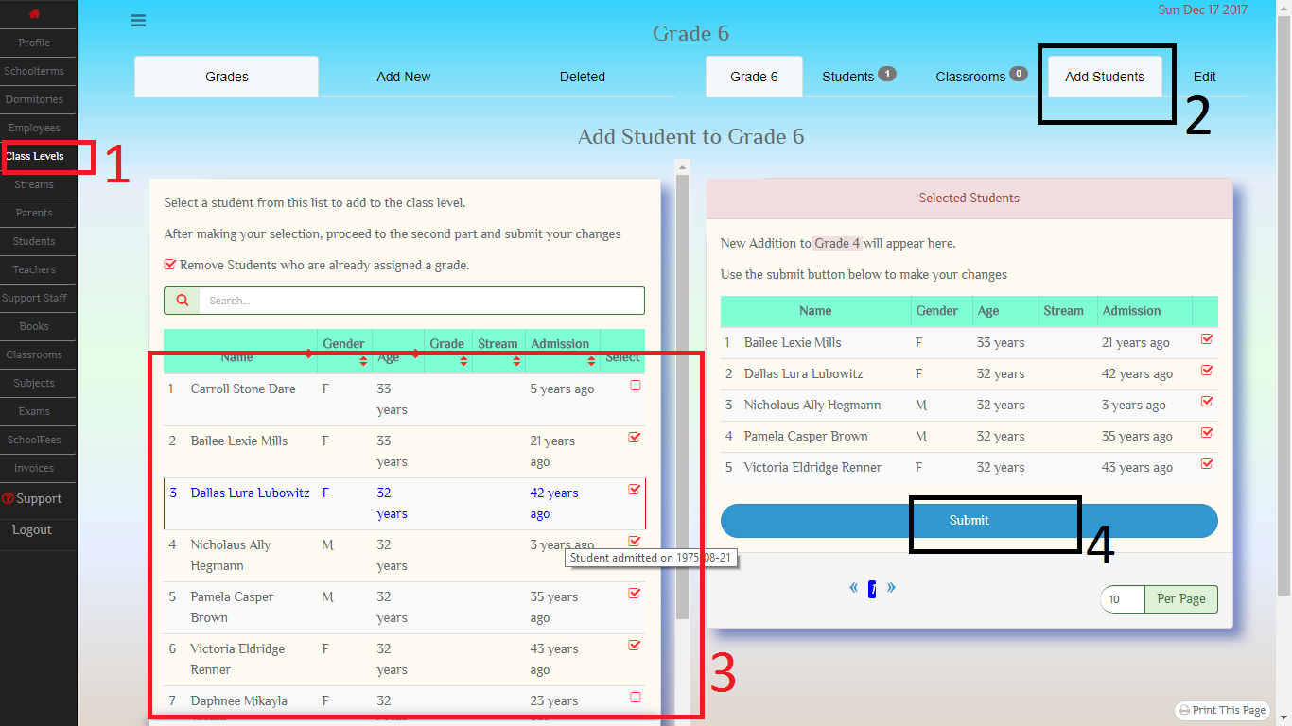
10.2 Add Students to Grade

Slide 25
10.3 Add Student to classroom
Two menus exists to add students to classroom.
You can use a simpler menu whereby you just populate the classroom with the students that have matching grade and stream, or
You can select individual students to add.

Slide 26
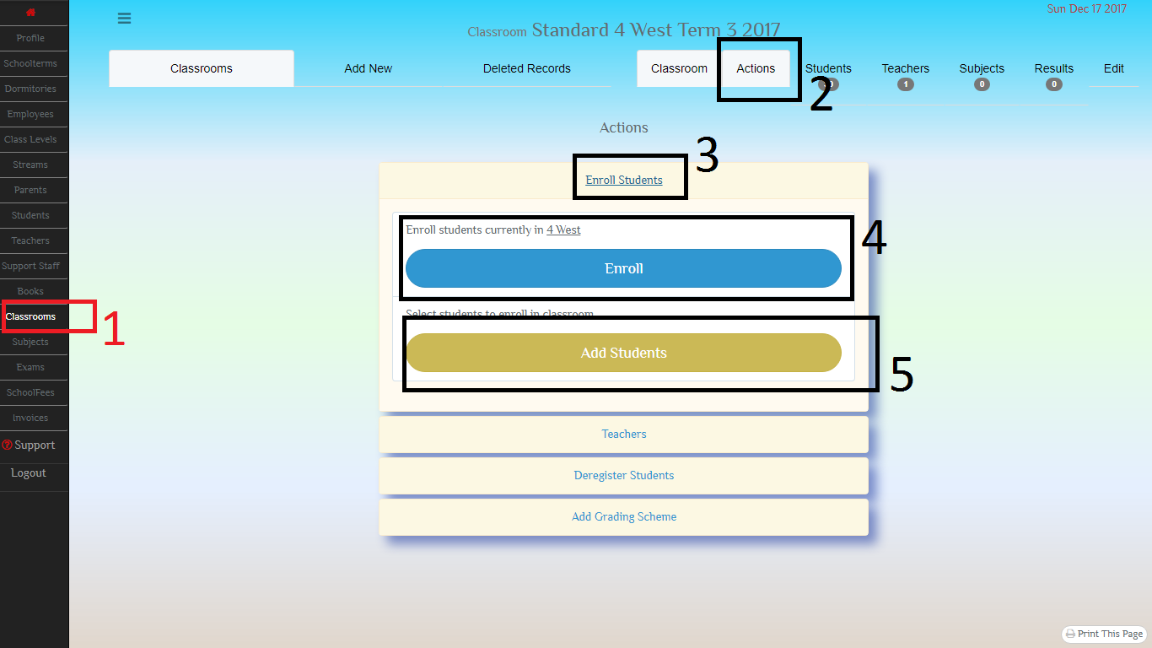
10.3.1 Click on [4] and all matching students are added, click on [5] to access more advanced select form

Slide 27
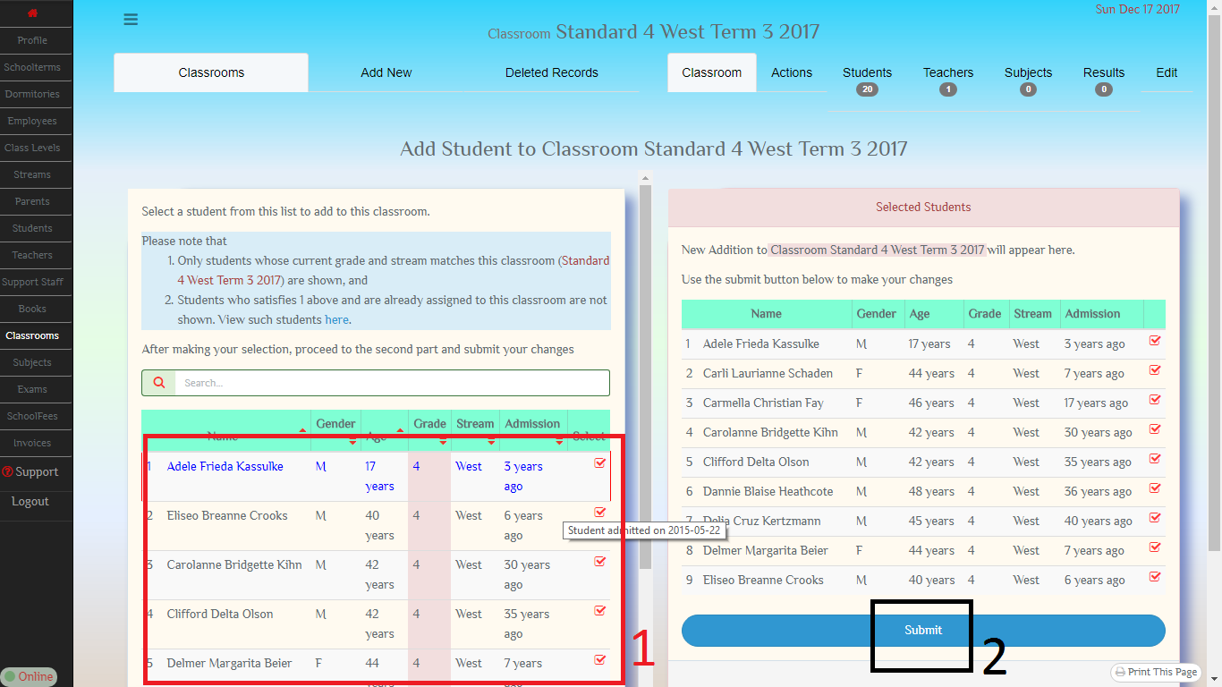
10.3.2 Add Students to Classroom, (Advanced)

Slide 28
11. Add subject
Next step is to add subjects.
A subject is attached to a classroom.

Slide 29
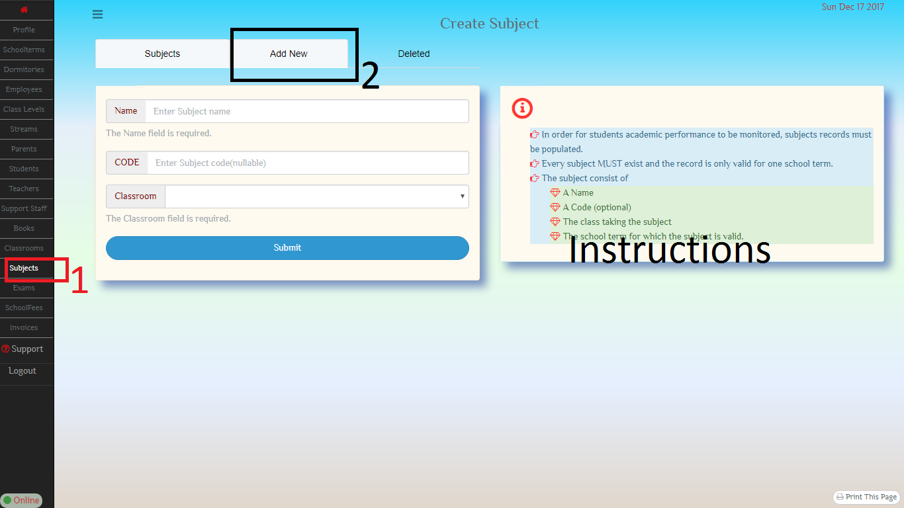
11.1

Slide 30
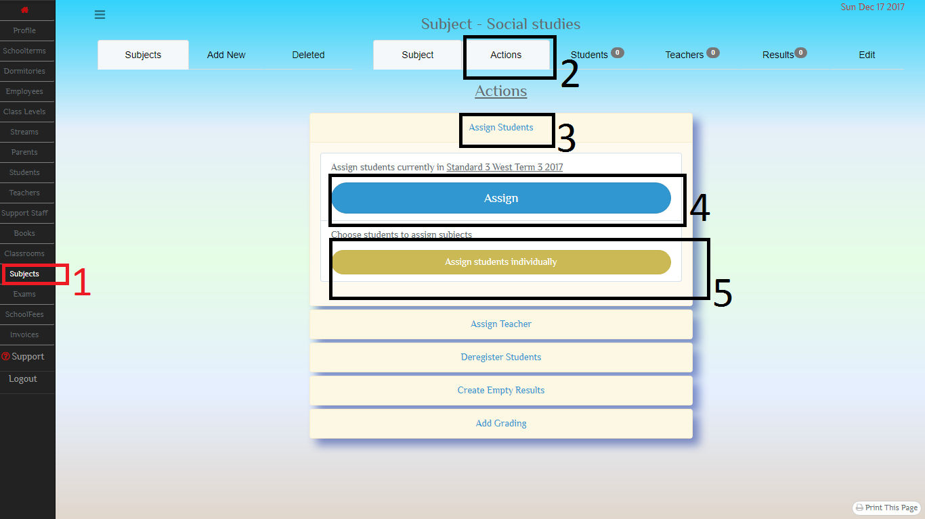
12. Add students to classroom click on [5] to access the advanced form

Slide 31
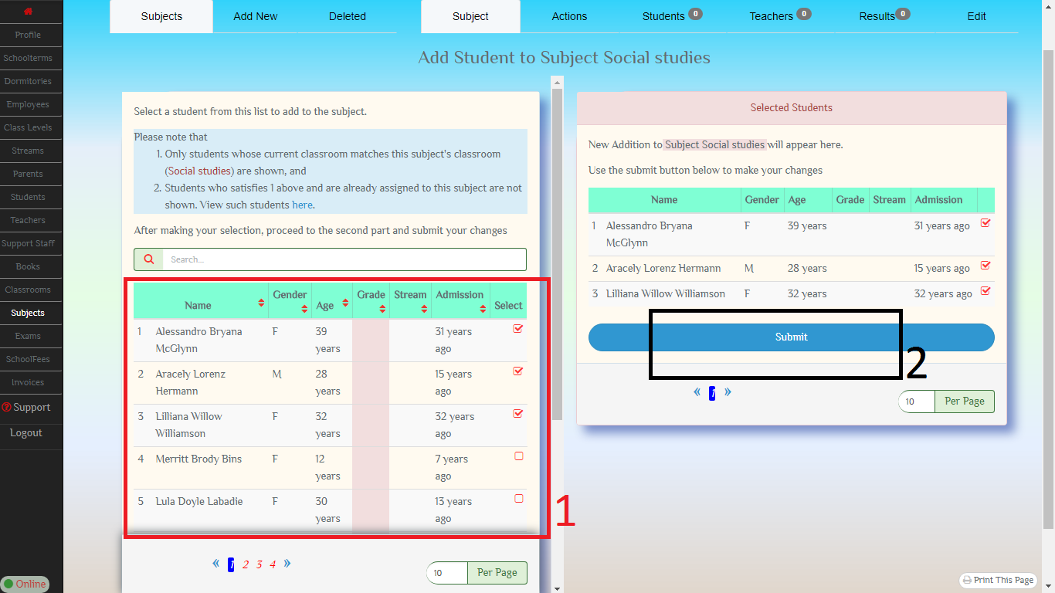
12.1 Add Students to Classroom Advanced

Slide 32
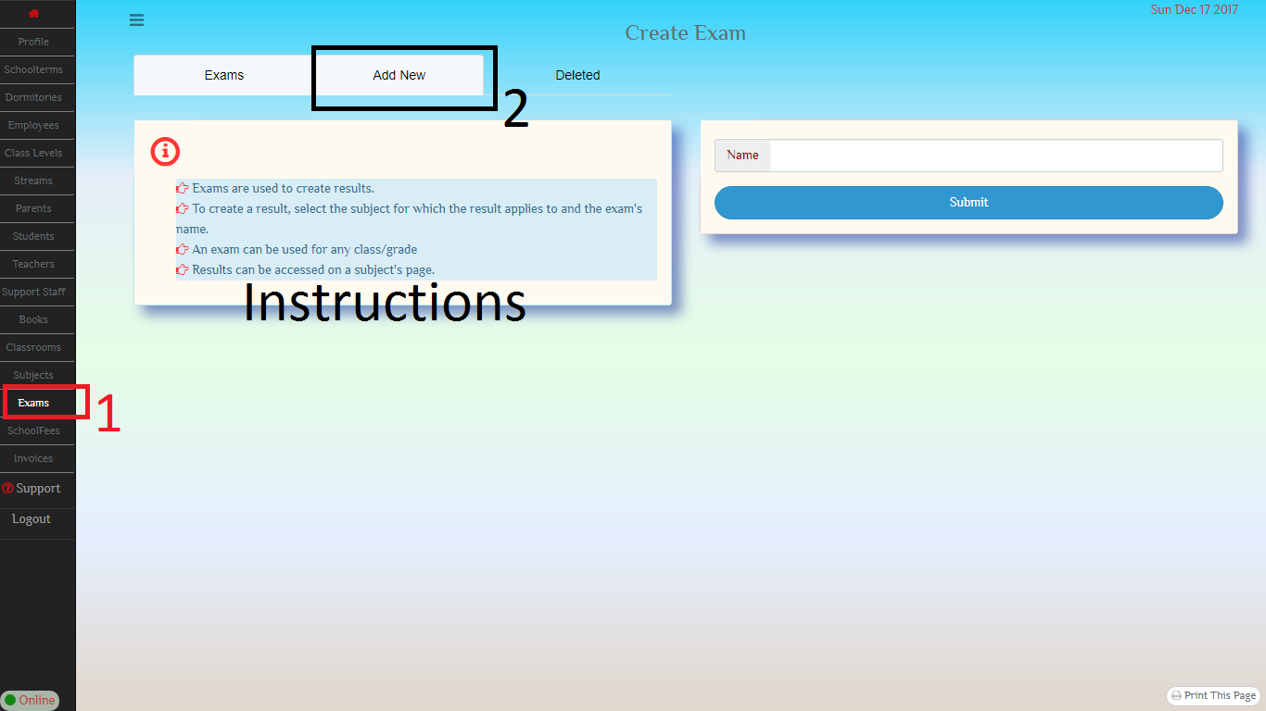
13. Add exam

Slide 33
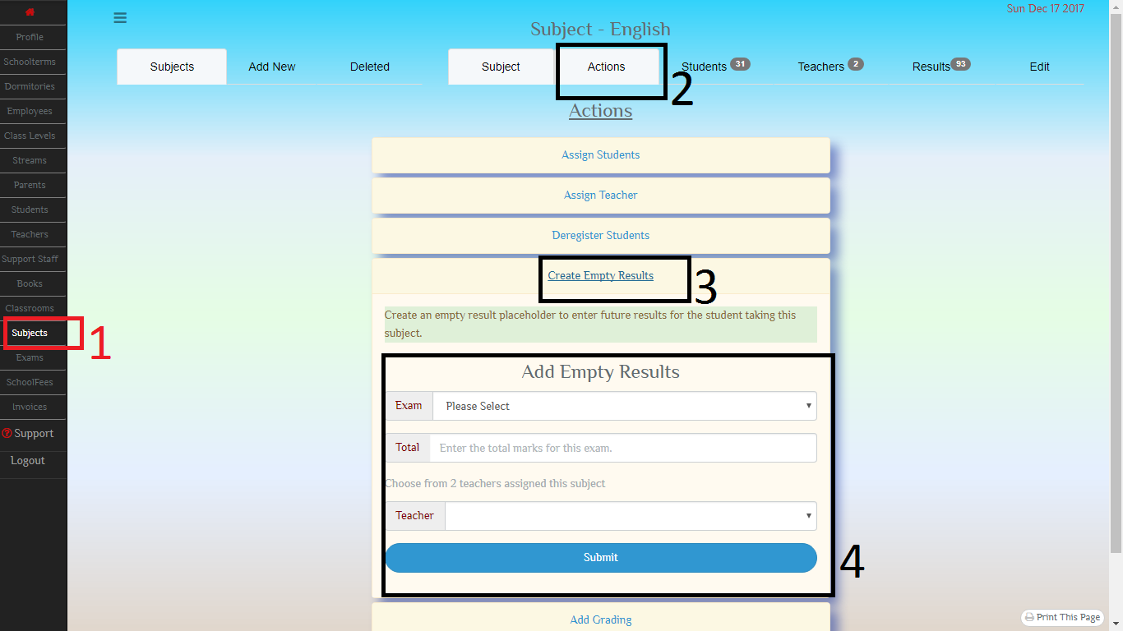
14. Create an empty Results set You will use this to enter results

Slide 34
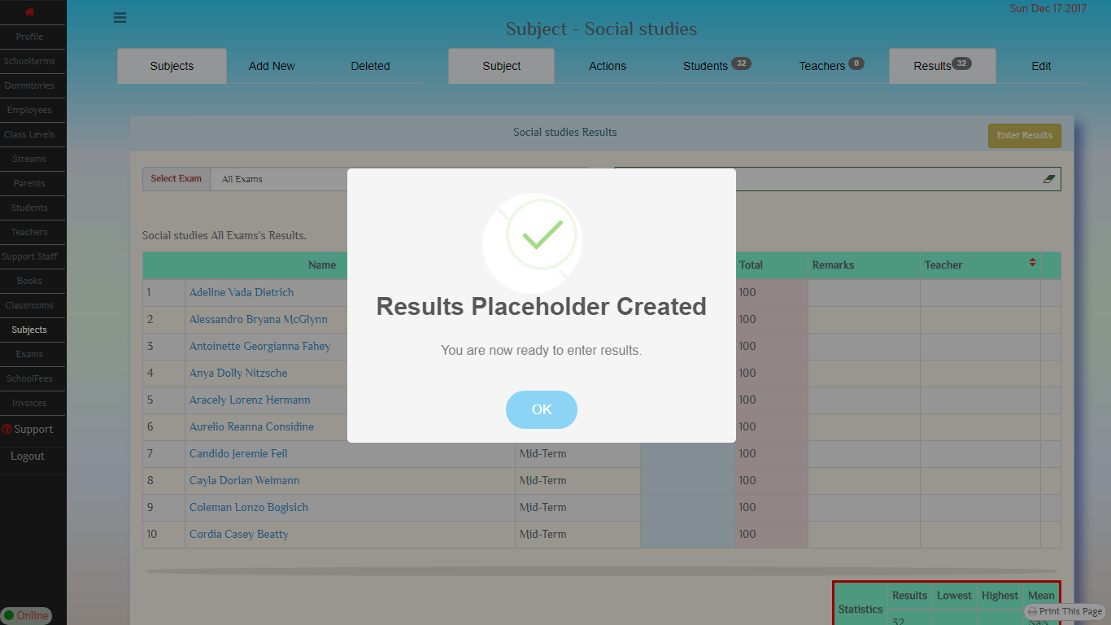
14.1 With an empty results placeholder, you are now ready to add results

Slide 35
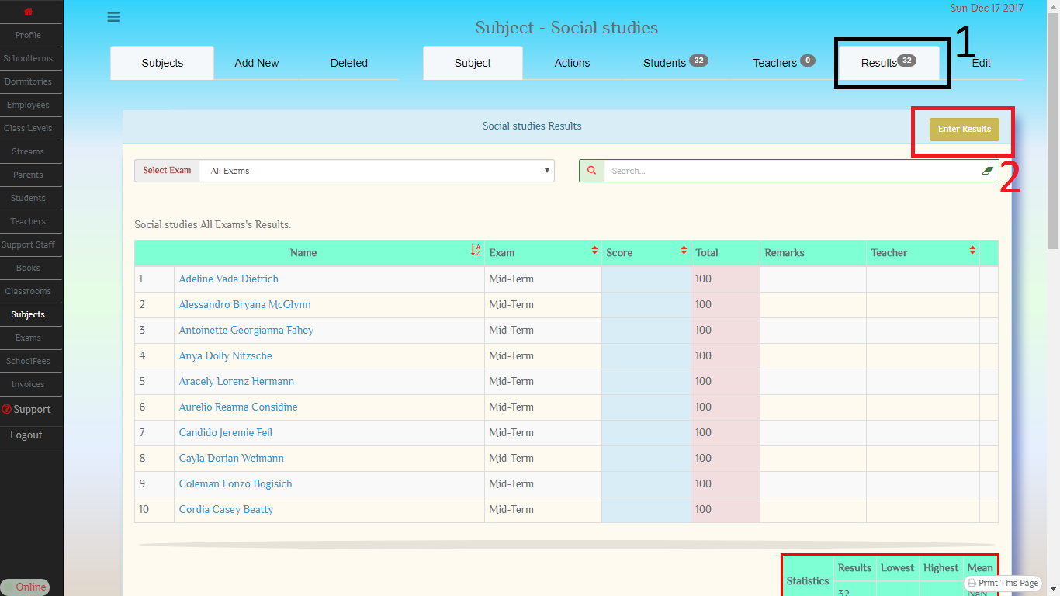
15. Enter Results From a subject’s page, select results [1] then, [2] to enter results.

Slide 36
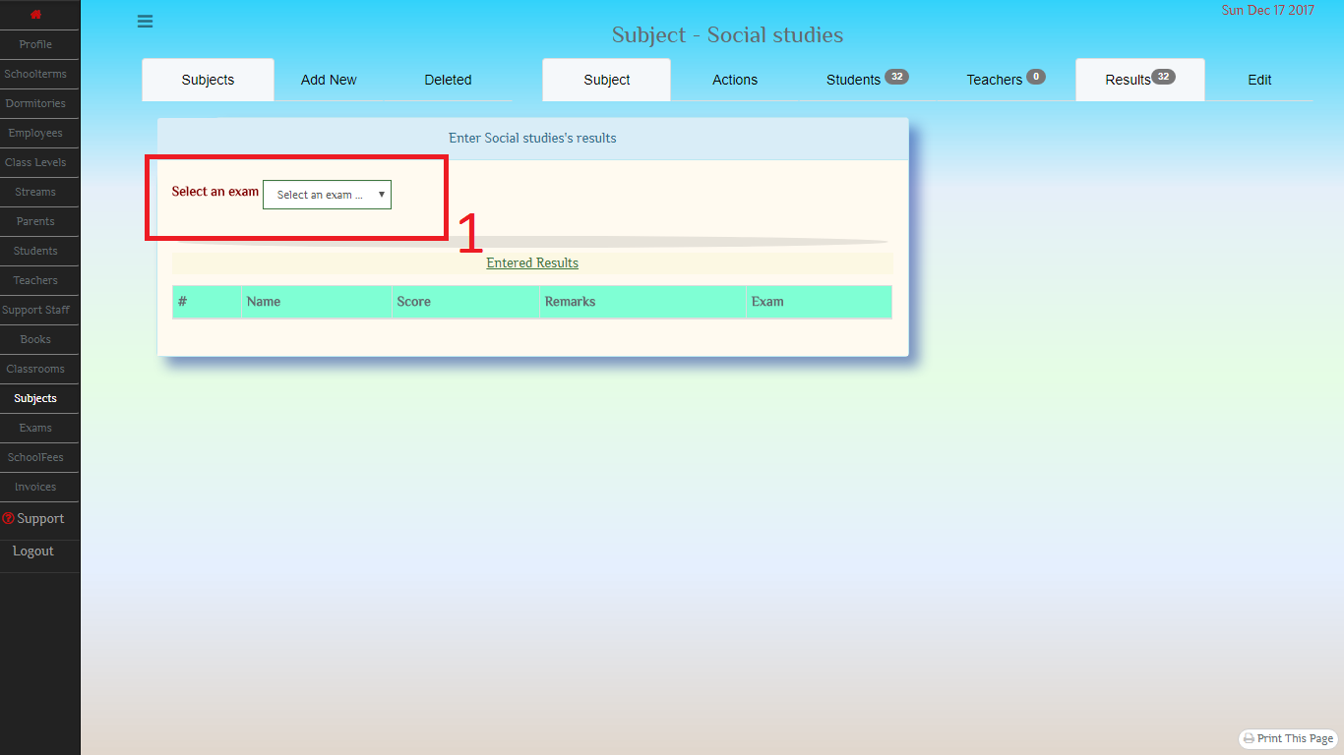
15.1.1 Select Exam

Slide 37
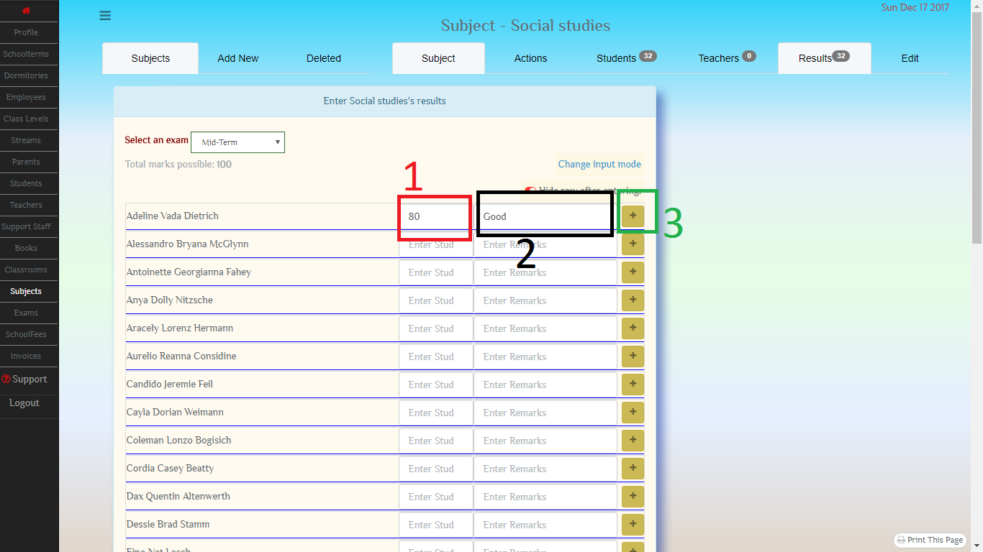
15.1.2 Add Results’ score [1] Add Remark [2] Commit results for saving [3]

Slide 38
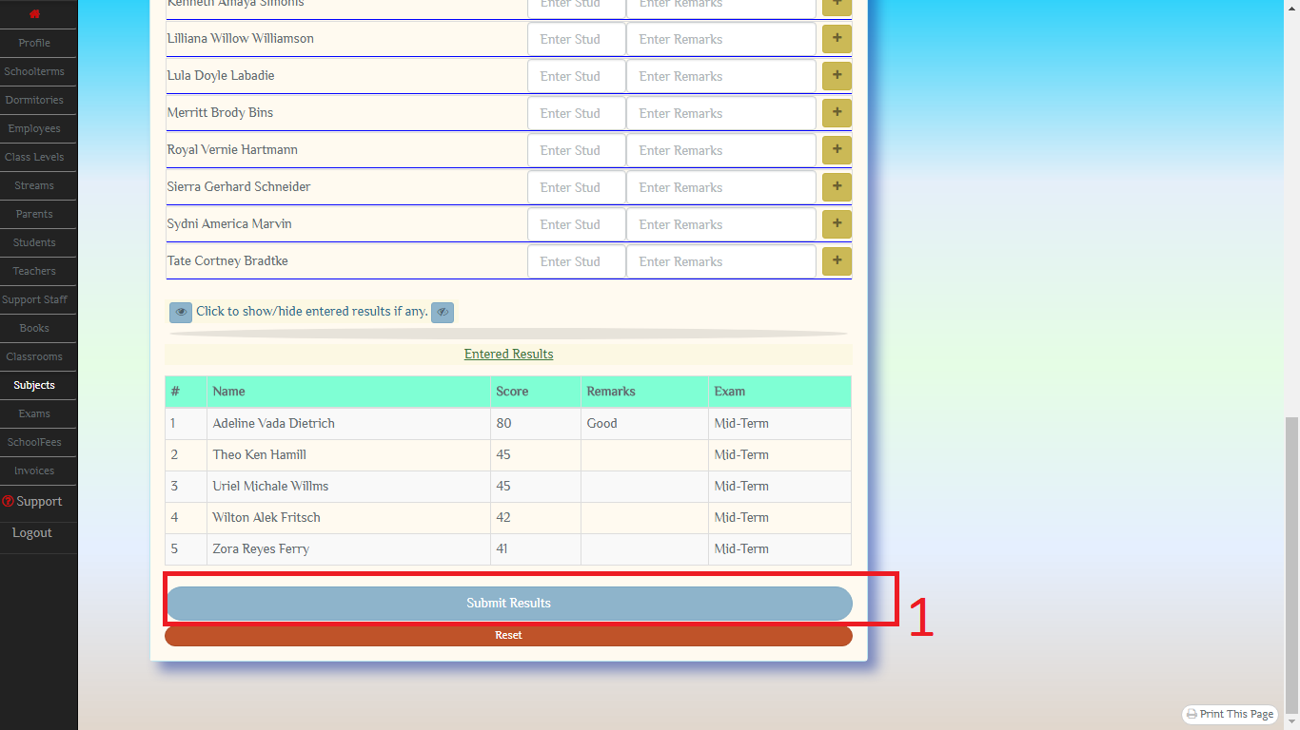
15.2 Scroll to bottom and submit your results

Slide 39
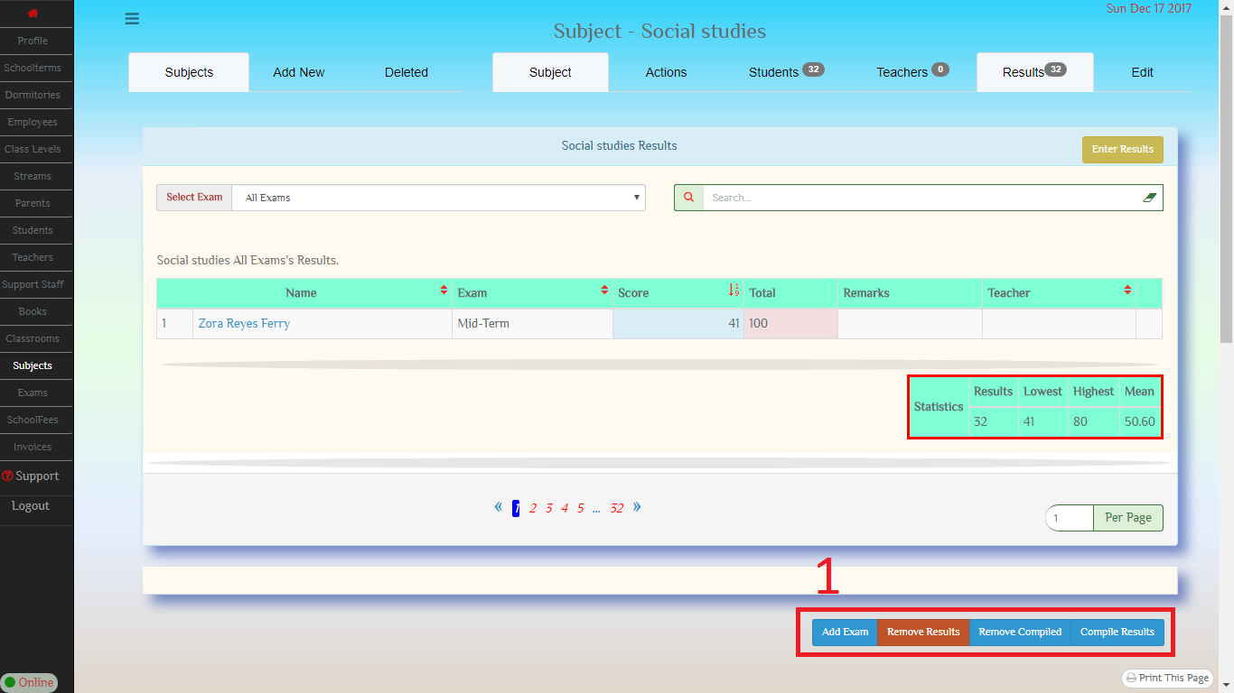
16. Addition functions for results can be found just beneath the results list

Slide 40
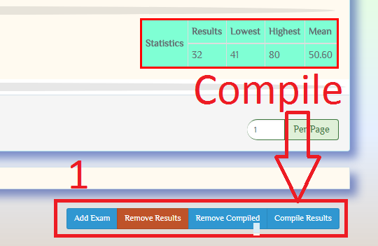
16.1. Compile results

Slide 41
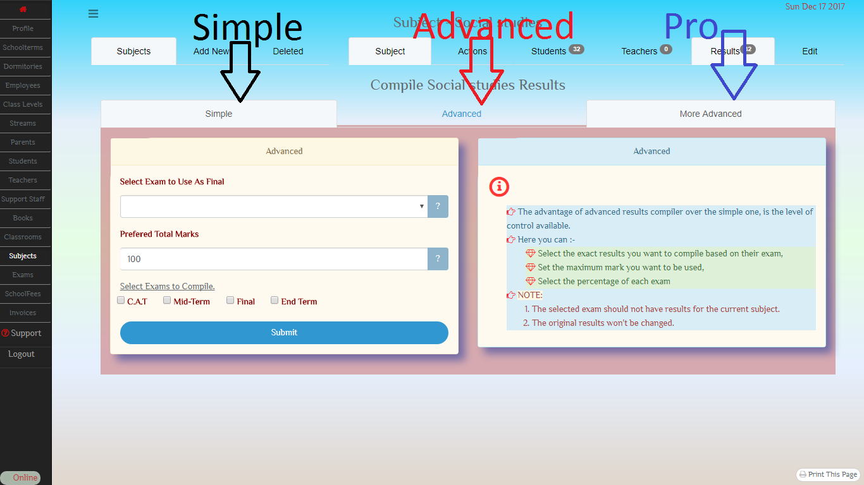
16.2 compile page 1. Simple, 2. Advanced 3. Pro

Slide 42
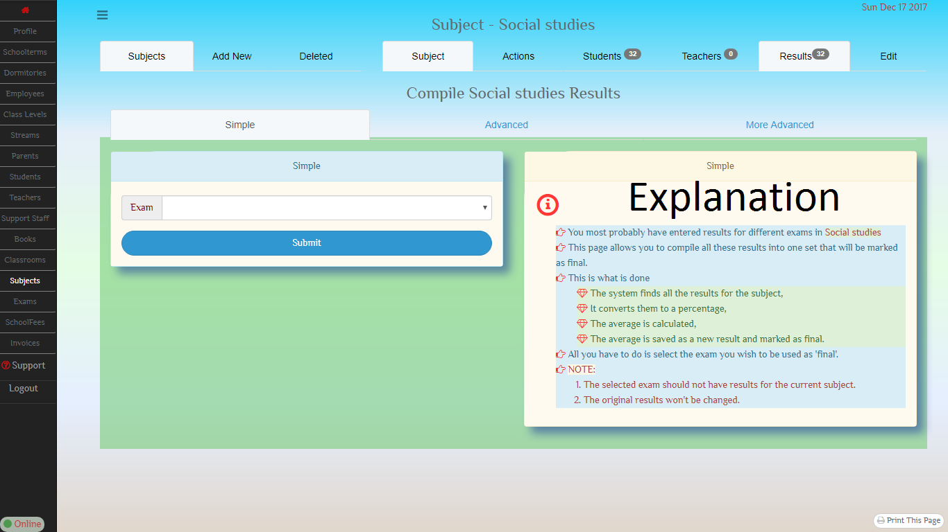
16.2.1 Simple Compilation

Slide 43
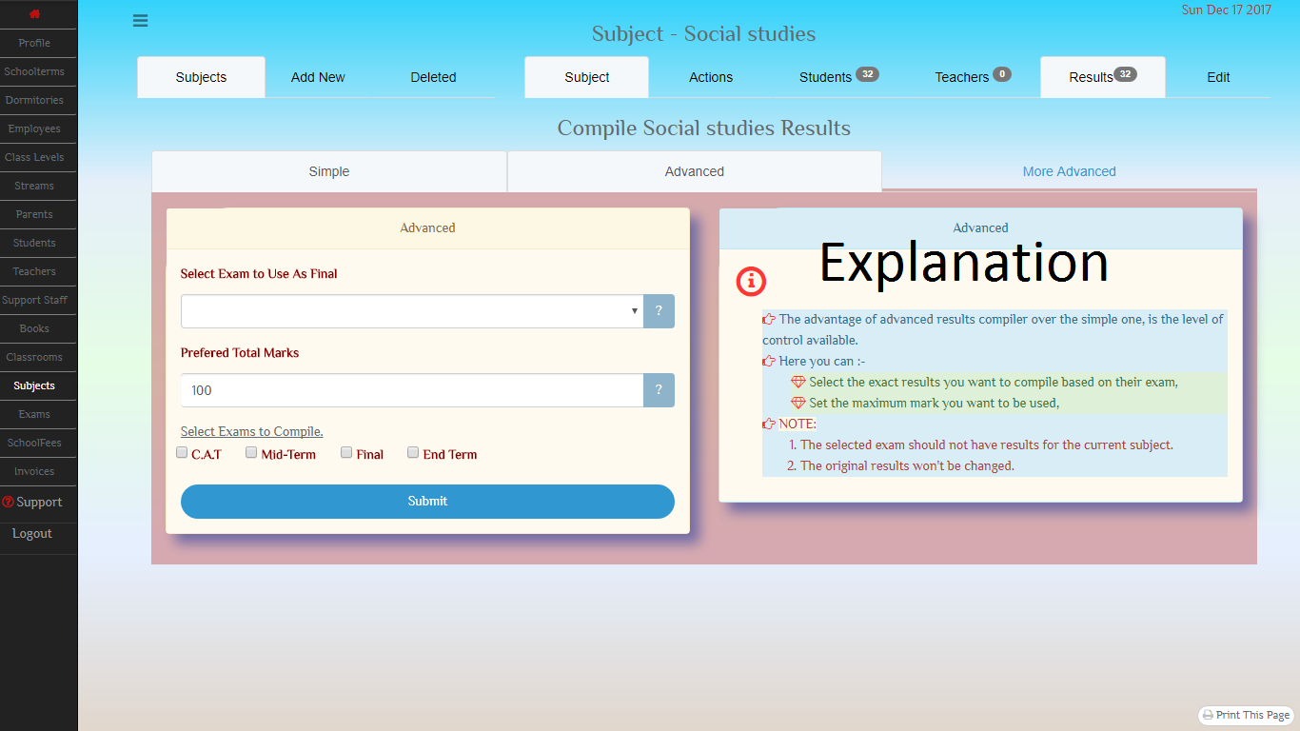
16.2.2 Advanced

Slide 44
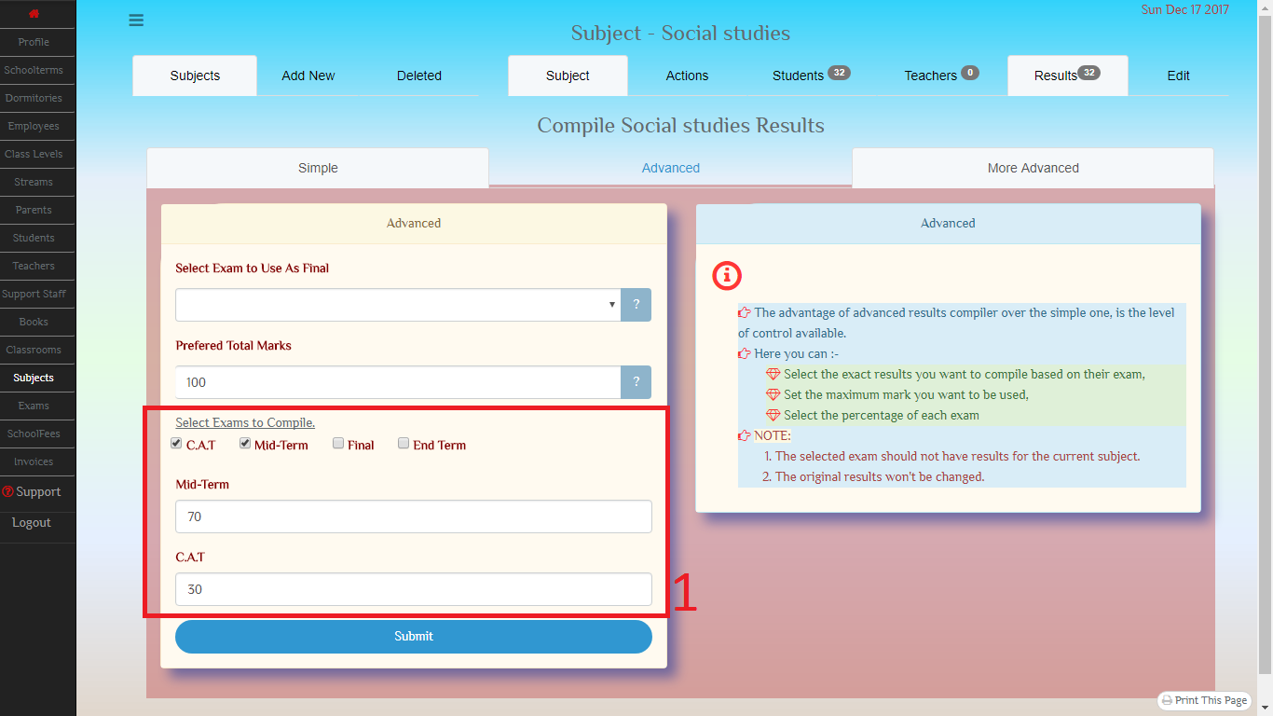
16.2.3 Pro With this system, you can set the percentage each exam should take in the total

Slide 45
16.3 Remove compiled.
Compiled results should not be edit.
When viewing results for a subject, the last column has a marker for compiled results.
If these results are editted, just delete them and recompile again.
You can find the link to do this just beneath the results lists and it is red in color.

Slide 46
17. Classroom Ranking
Remember that the subject is associated to a classroom?
When you add results for a subject, you can view the totals for that classroom’s subjects.
KEEP IN MIND that only results that are associated to the same exam can be added together.
The classroom ranking has two type of total,
ABSOLUTE TOTAL – simply adding together
AVERAGED TOTAL – incase all results do not share the same total marks, they are averaged first.
More information can be found on the classroom results page.

Slide 47
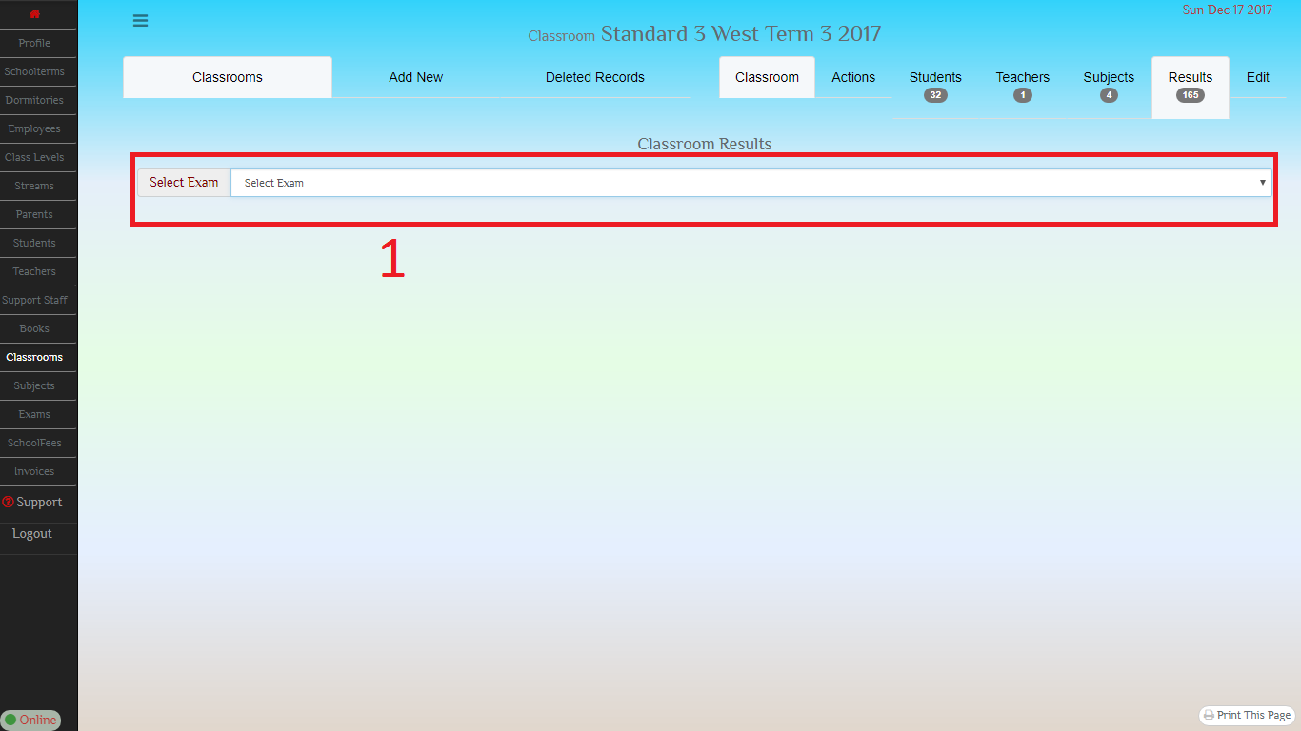
17.1 Classroom results Select Exam

Slide 48
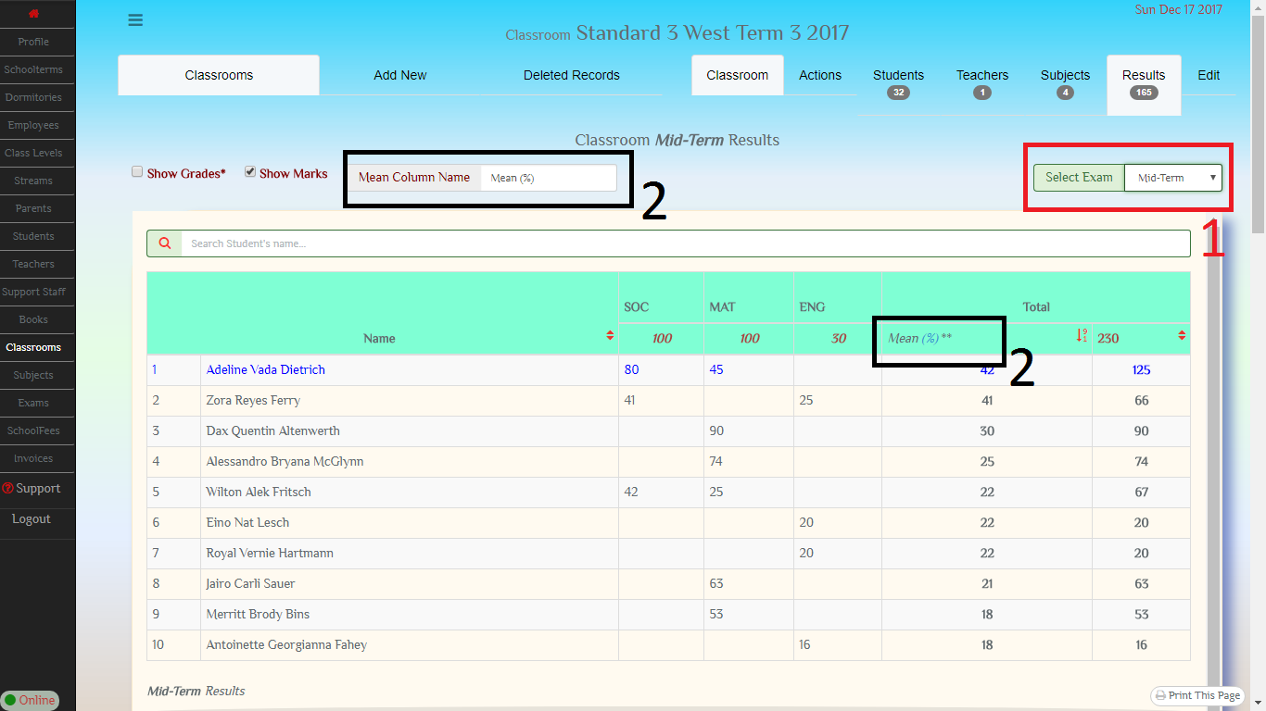
17.2 Classroom Results Part [2] Enter the name of the mean column incase you are printing

Slide 49
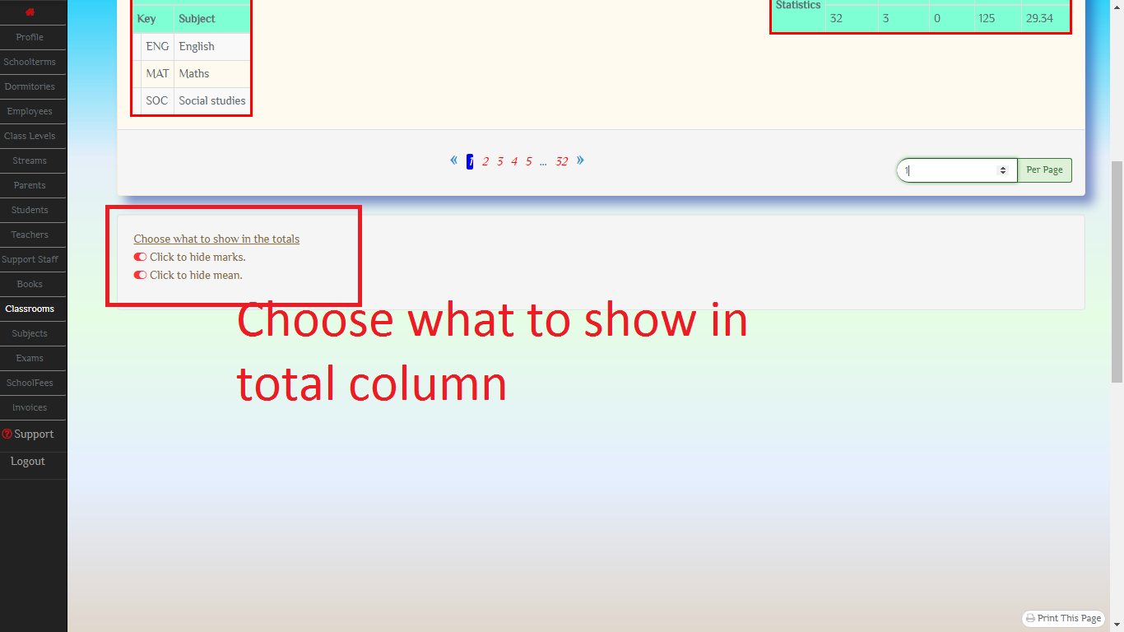
17.3 Classroom results

Slide 50
18. Subect and classroom Grades
You can gradings to use for your subjects and classrooms.
Each grading scheme can only be used by its owner, either a classroom or a subject.
Effort have been made to ensure the correctness of the scheme, but the user should also exercise caution when creating a scheme.
You can not edit a scheme once created, you will have to delete it first and create a new one.

Slide 51
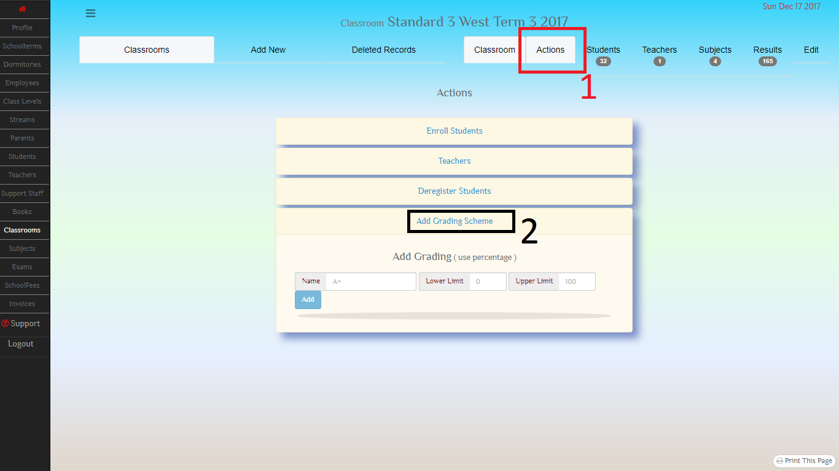
18.1 Classroom Grading scheme

Slide 52
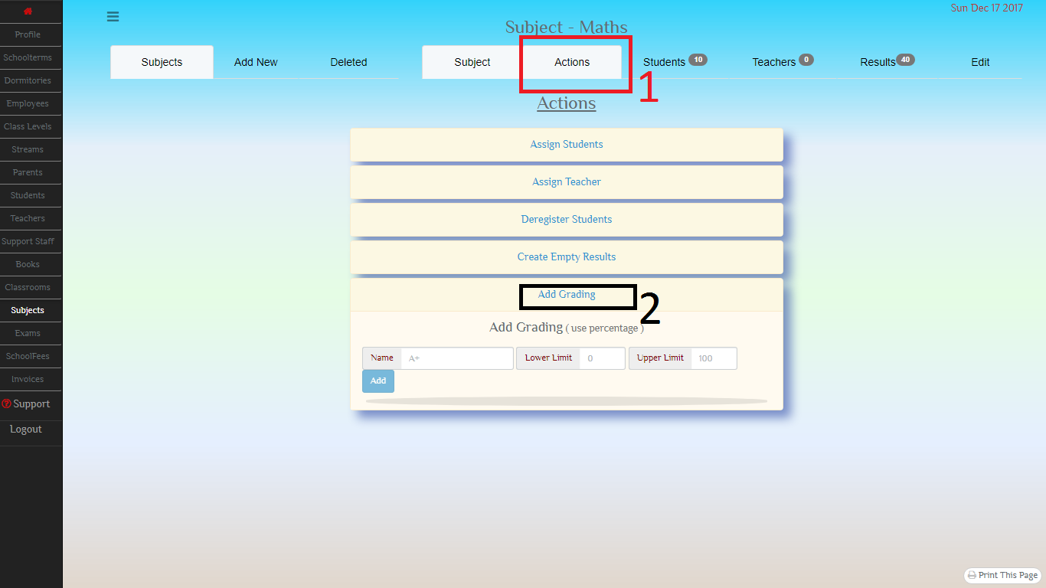
18.2 Subject Grading scheme

Slide 53
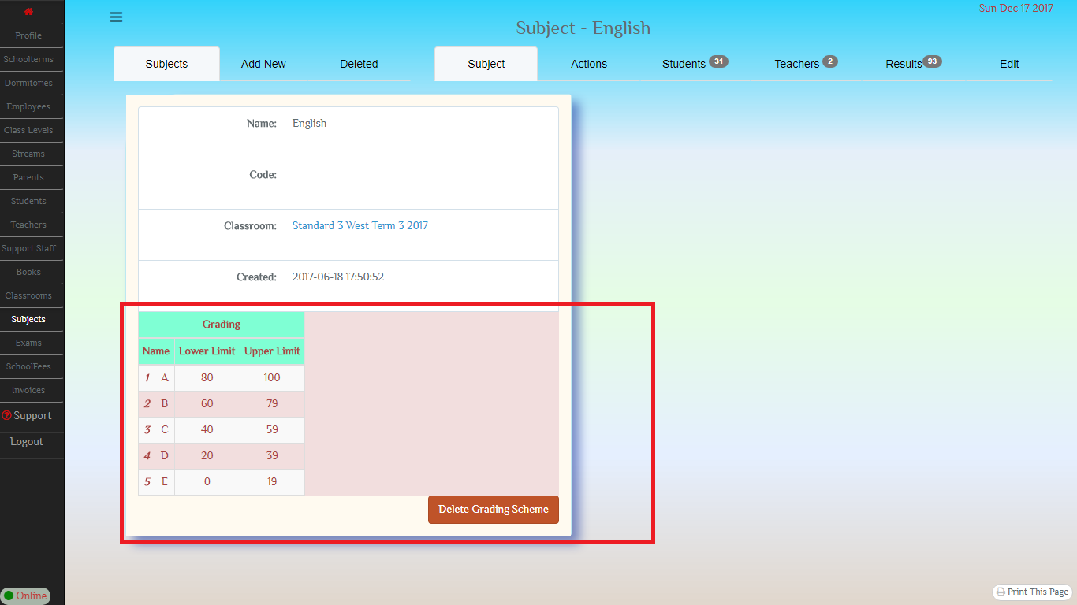
18.3 Example Grading

